Slide 1



Ad_Hoc Insights
Consumer Goods
Created by
Abhinandhan

Slide 2
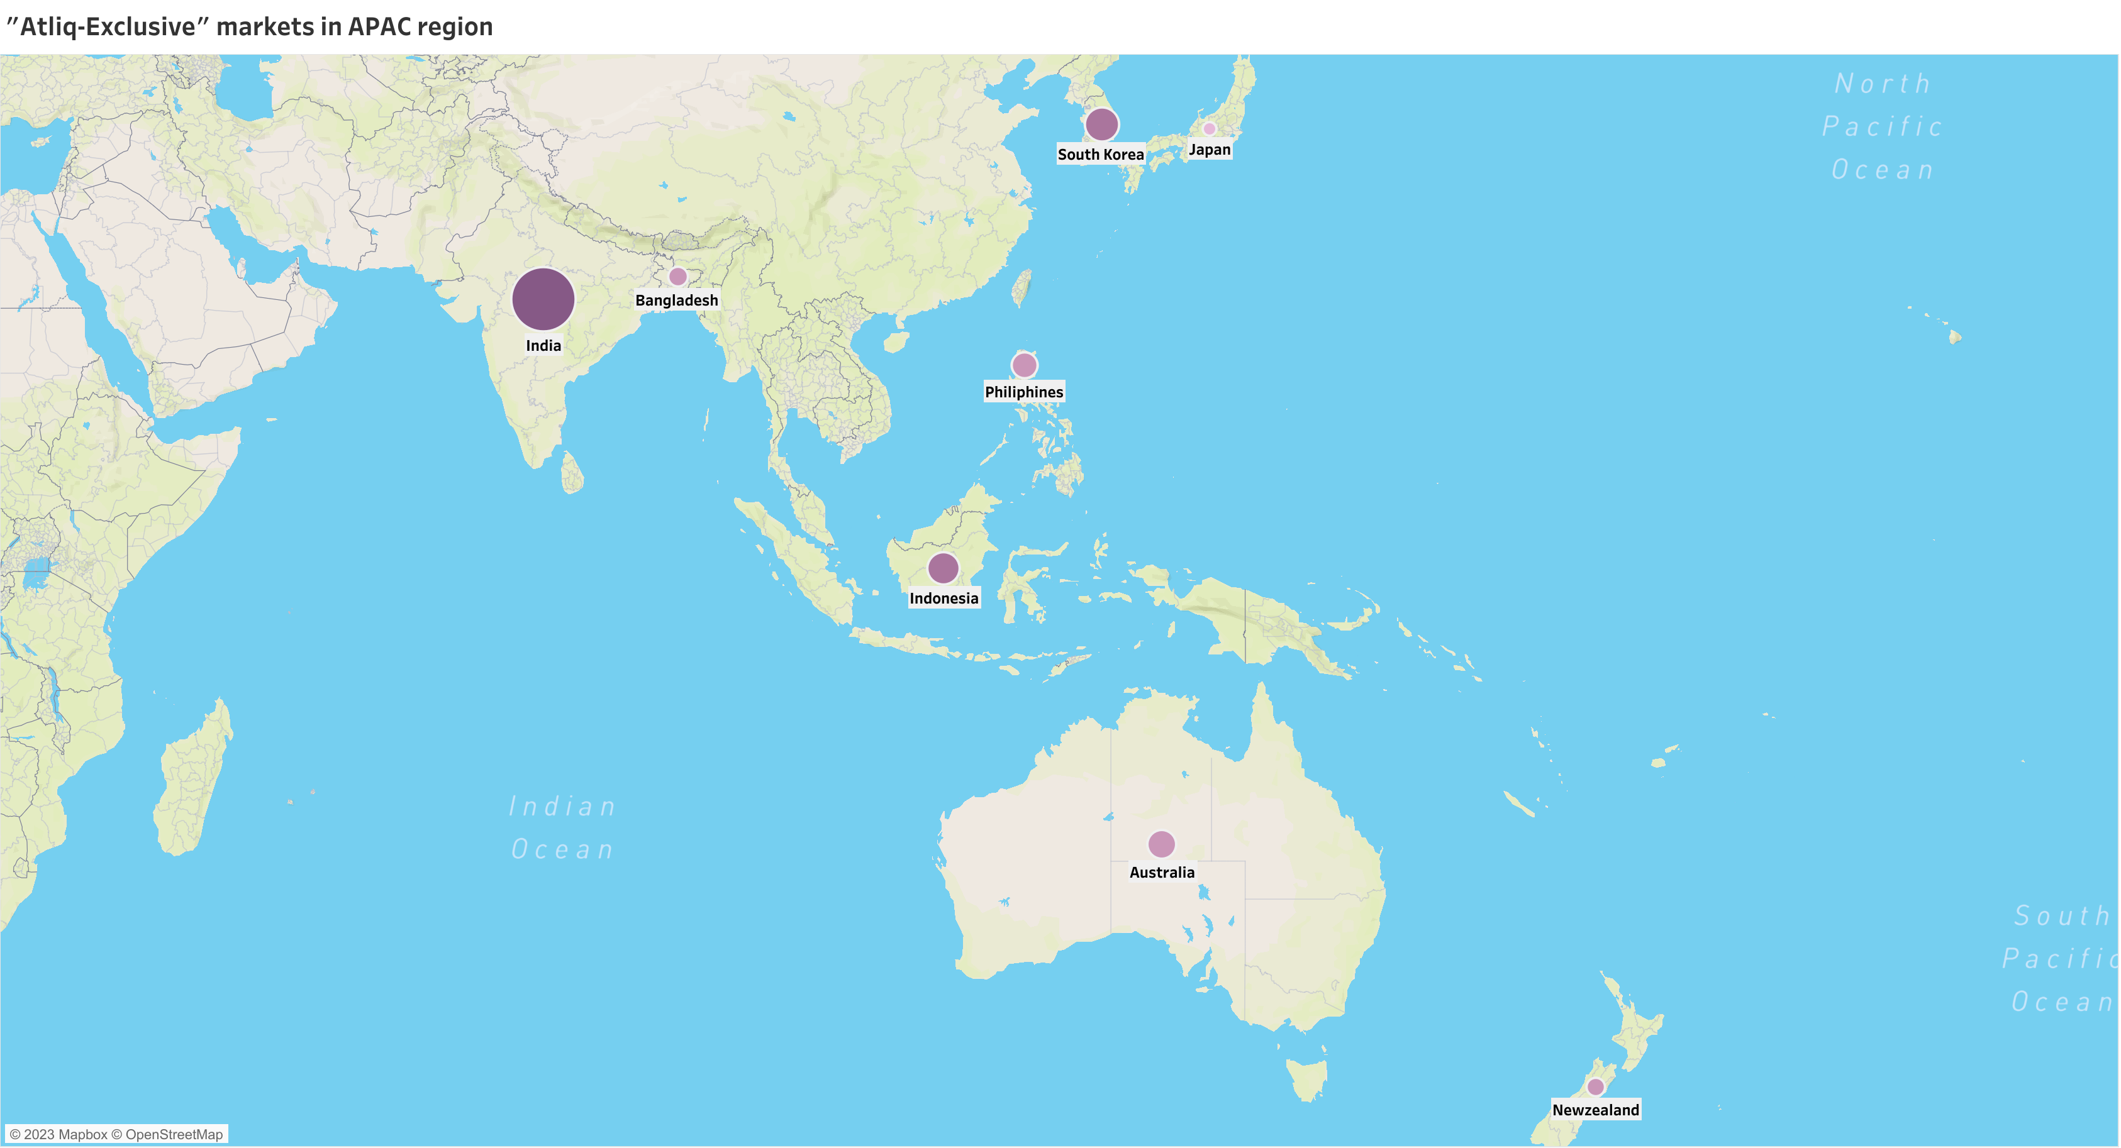
1. Provide the list of markets in which customer “Atliq Exclusive” operates its business in the APAC region.
INSIGHTS
Atliq Exclusive operates its business in 8 major markets for Asia Pacific region
Atliq Exclusive has the most stores in APAC region followed by EU(6) and NA(2)

Slide 3
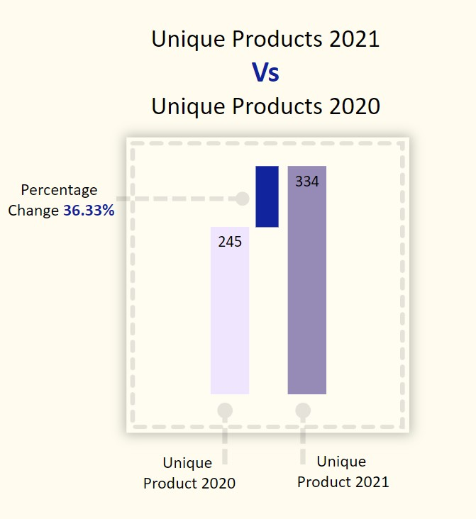
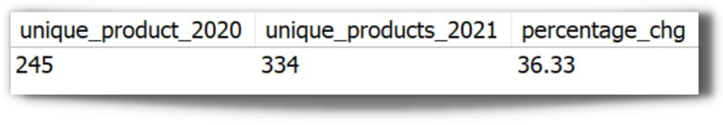
2. What is the percentage of unique product increase in 2021 vs 2020
INSIGHTS
With a 36.33% increase in new products, Atliq hardware is building a strong and dynamic reputation by meeting with the changing needs of the customer

Slide 4
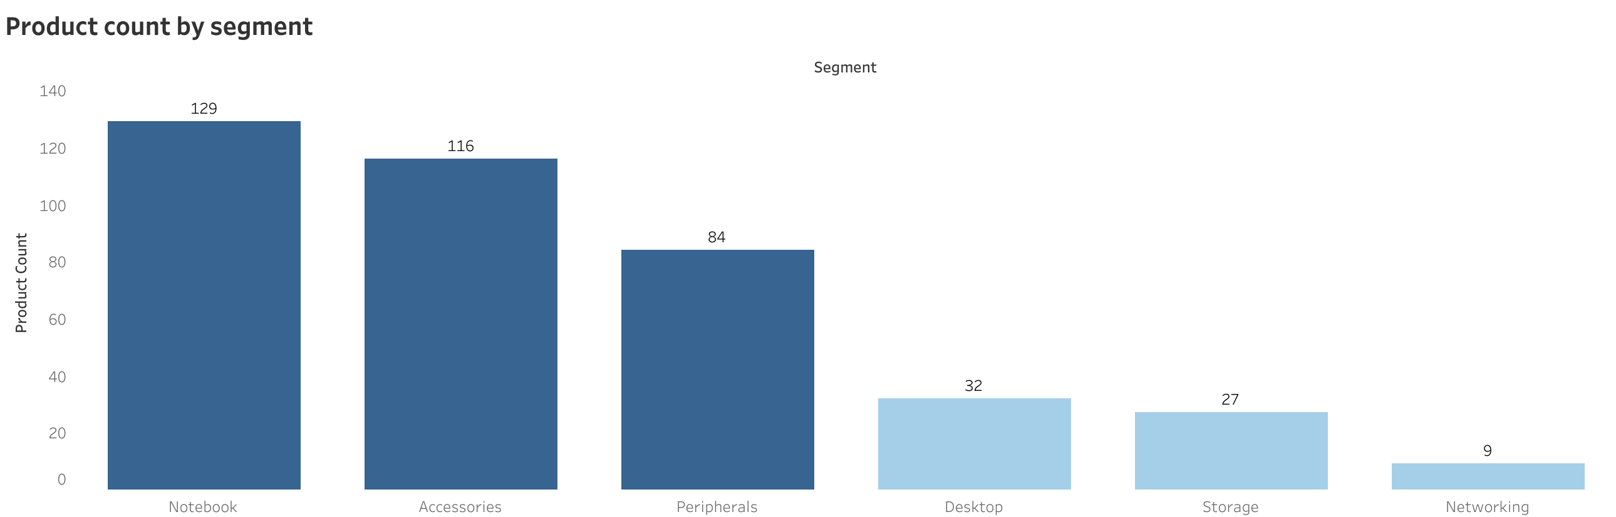
3. Provide a report with all the unqiue product counts for each segment and sort them in descending order of product counts
INSIGHTS
We have a wide range of products under segment: Notebook, Accessories and Peripherals averaging around 110 while segment like Desktop, Storage and Network are lagging with an average of 23 products per segment
Product development team needs to evaluate on products that require redesigning as per modern standards

Slide 5
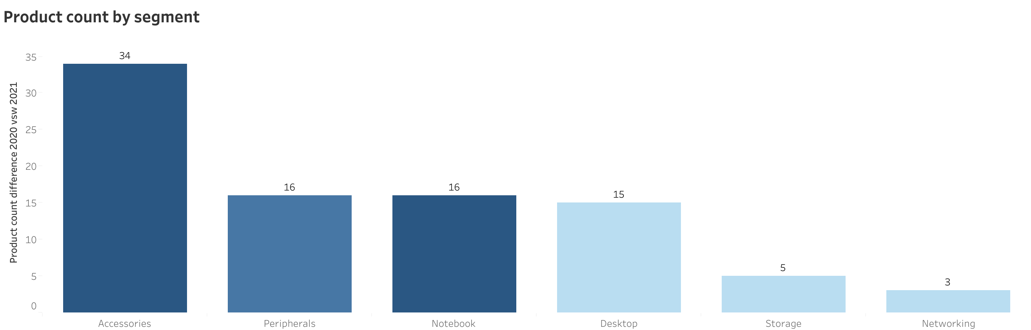
4. Follow-up: Which segment had the most increase in unique products in 2021 vs 2020
INSIGHTS
With the introduction of 34 new products, Accessories segment has the highest increase in number of unique products
Notebook and Peripherals each has an increment of 16 new unique products
Product development has done a good job in the Desktop segment by increasing unique products from 7 to 22
Networking segment is at the bottom with 3 new products introduced since 2020

Slide 6
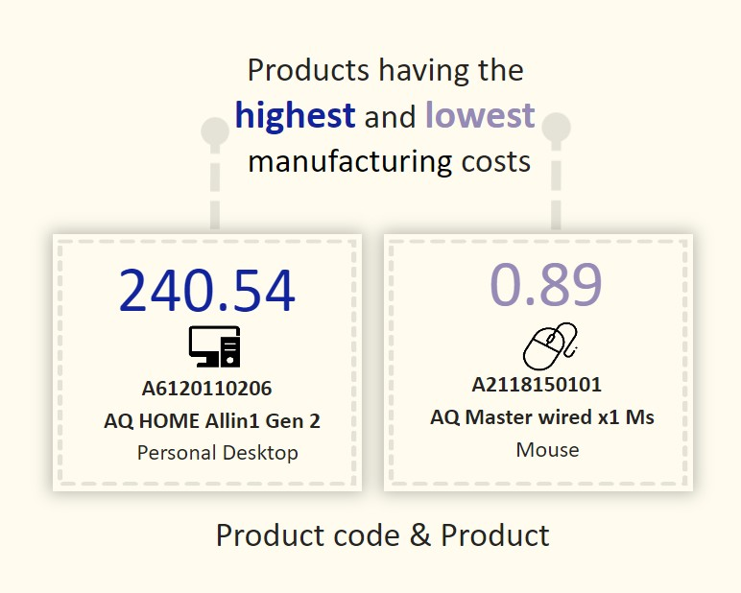
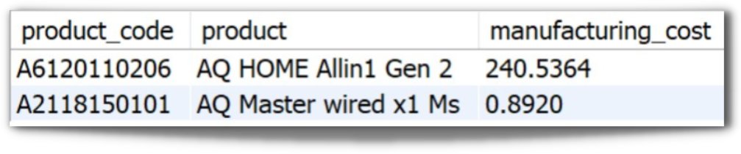
5. Get the products that have the highest and lowest manufacturing costs
INSIGHTS
Mouse AQ Master wired x1Ms (Variant: Standard 1) has the lowest manufacturing cost.
Personal Desktop: AQ Home Allin1 Gen2 (Variant: Plus 3) has the highest manufacturing cost.

Slide 7
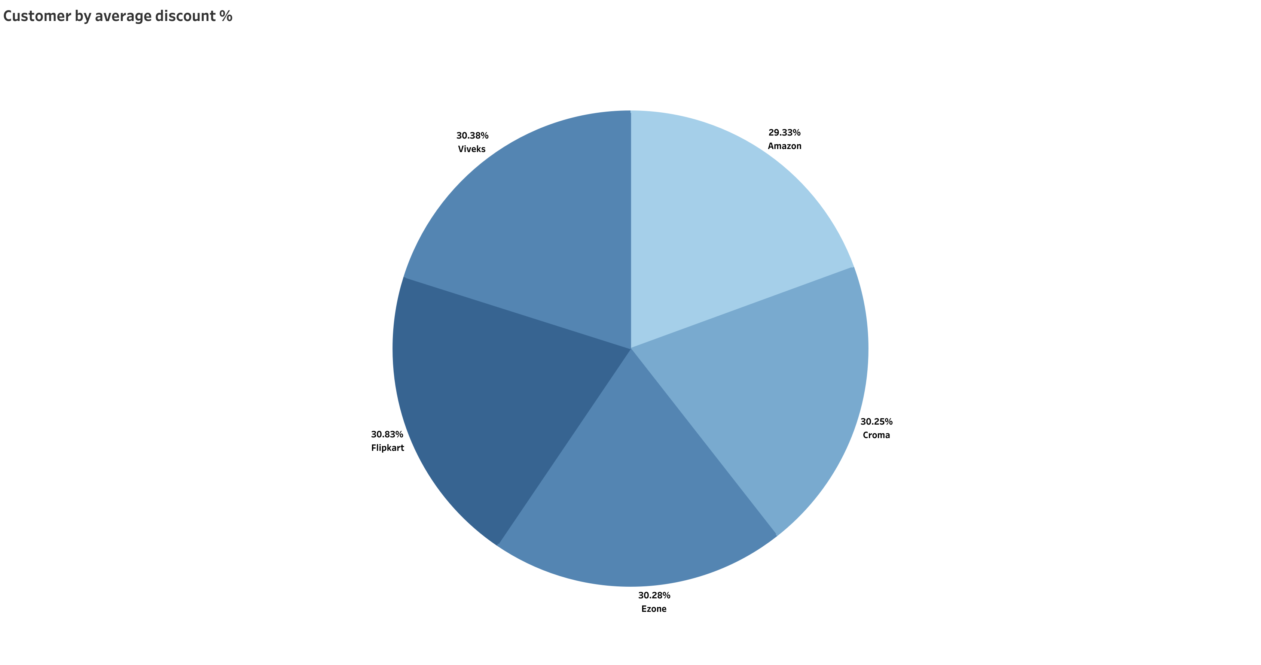
6. Generate a report which contains the top 5 customers who received an average high pre_invoice_discount_pct for the fiscal year 2021 and in the Indian market
INSIGHTS
Flipkart has received the highest pre_invoice discount percent i.e., 30.83%
Top 5 customers have a collective average around 30.21%
FY 2021, Average discount provided to all customers in Indian market was 24.16%

Slide 8
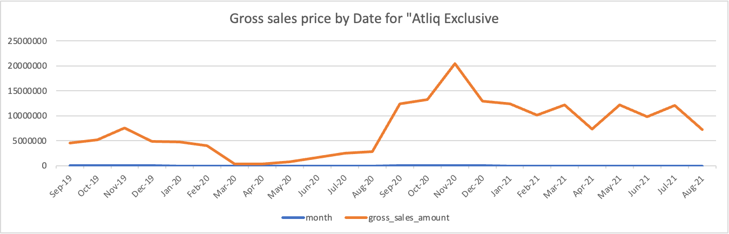
7. Get the complete report of the Gross sales amount for the customer “Atliq Exclusive ” for each month
INSIGHTS
For Atliq-Exclusive store maximum sales were recorded in November - 2020 ($20.46 Million) and lowest sakes recorded in March – 2020 ($0.38 Million)
Low sales from March to August were due to pandemic when stores were shut
Sales started improving from September – 2020 onwards due to ease in lockdown restrictions and the onset of festival season in India and other markets

Slide 9
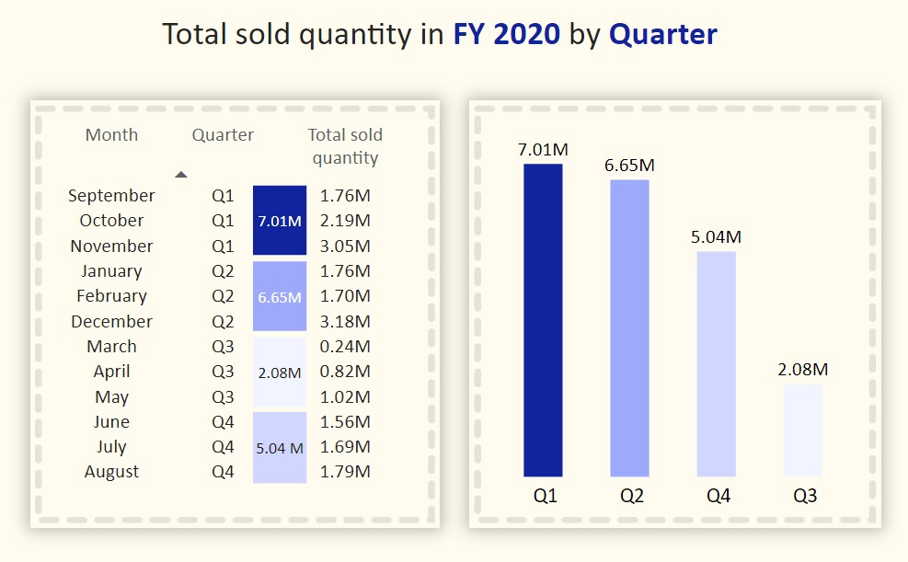
8. In which quarter of 2020, got the maximum total_sold_quantity.
INSIGHTS
Q1 (September-November) had the maximum quantity sold for FY 2020
Sales dropped in Q3 (March-May) because of pandemic
Increase in sales recorded in Q4 (June-August)

Slide 10
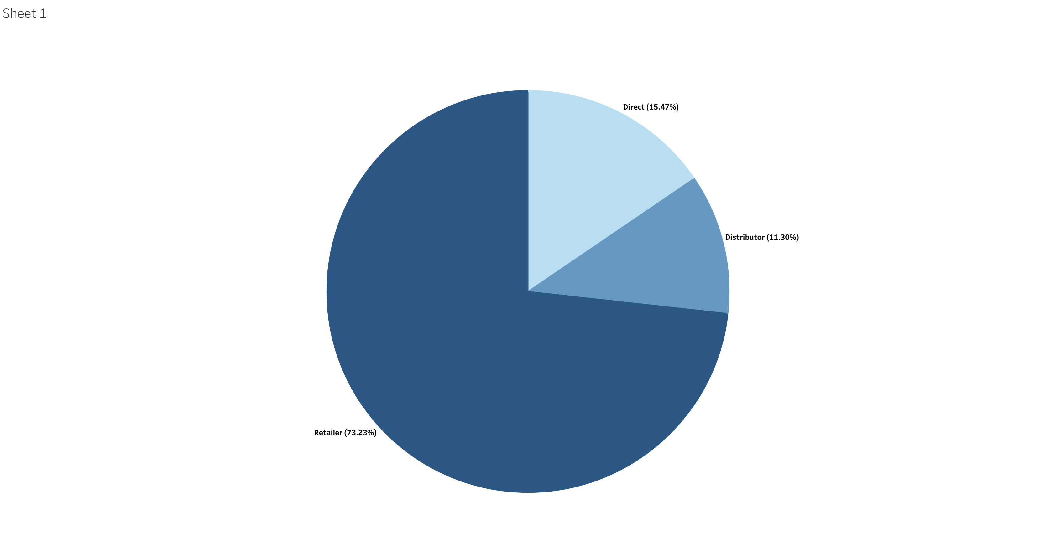
9. Which channel helped to bring more gross sales in the fiscal year 2021 and the percentage of contribution
Retailers with $1219.08 Million which is 73.23% of gross sales for FY 2021 followed by Direct channel with $257.53 Million and Distributor with $188.03 Million

Slide 11
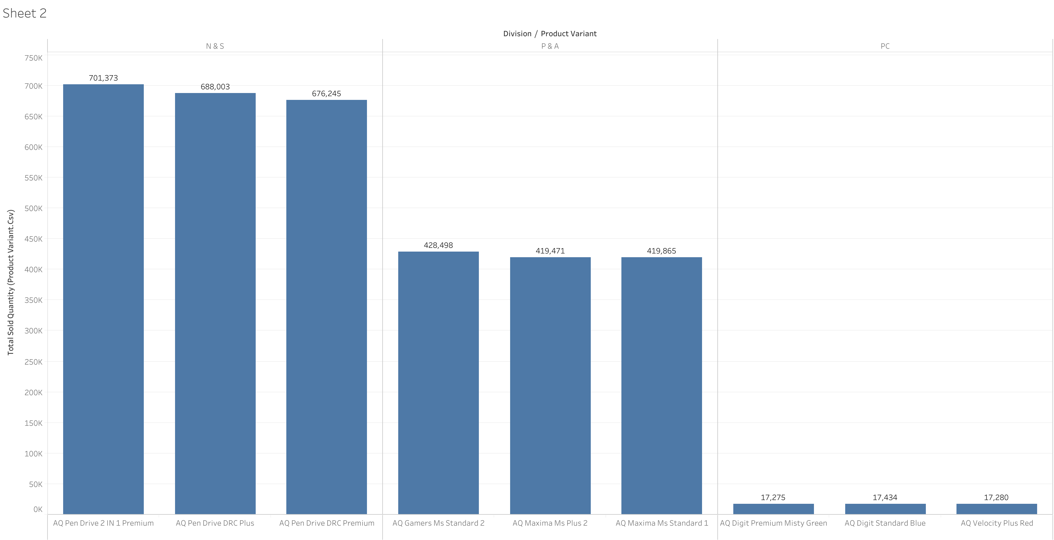
10. Get the top 3 products in each division that have a high total_sold_quantity in the fiscal_year 2021
INSIGHTS
For N&S, the top selling product is AQ Pen Drive 2 IN 1 with a total of 7,01,373 quantities sold in FY 2021 followed by two variants of AQ Pen Drivwe DRC with 6,88,003 and 6,76,245 quantity sold respectively
For P&A, top selling product is AQ Gamers Ms with 4,28,498 quantities sold followed by two variants of AQ Maxima Ms
For PC, top selling product is AQ Digit PC with 17,434 quantities sold
The company can take some strategic decisions to improve sale in PC division

Slide 12



Thank you
Tools used : Mysql, Tableau and Power point presentation.
Data Source : Consumer Goods Ad_Hoc Insights.

